Slide 1



Web foundations (2)
By Elham Jaffar

Slide 2
Udacity Feedback extension
Have you installed this feature ?
If Not, Click Here

Slide 3
Why is it important to learn HTML & CSS?
Easy script language
You can share the file with anyone
Runs in all devices since its responsive
Can be customized

Slide 4
Some definitions
HTML - HyperText Markup Language - the standard markup language used to create web pages.
CSS - Cascading Style Sheets - style sheet language used for describing the look and formatting of a document written in a markup language.
DOM - Document Object Model - a cross-platform and language-independent convention for representing and interacting with objects in HTML

Slide 5
Still confused ?
HTML and CSS are both "languages”
HTML controls the "structure" of a web page
CSS controls the "style" of a page (how it looks)
When programmers talk about the "DOM" (Document Object Model) they are talking about the tree-like structure of a page.

Slide 6
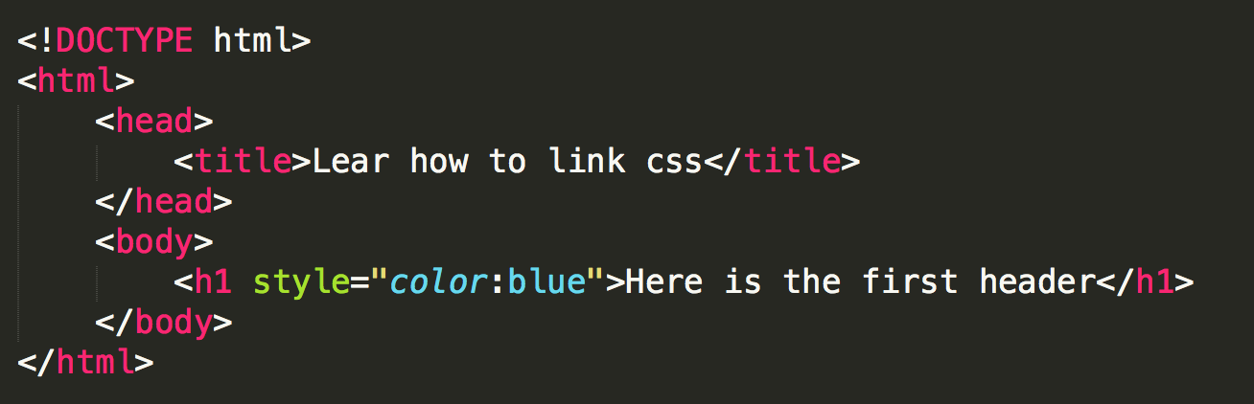
How to add CSS?
Inline

Slide 7
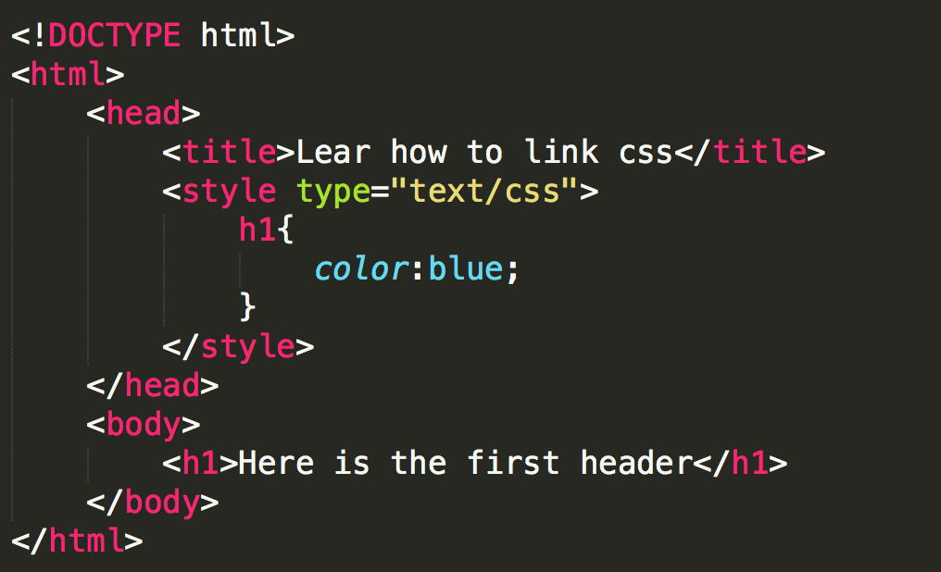
How to add CSS?
Style Tag

Slide 8
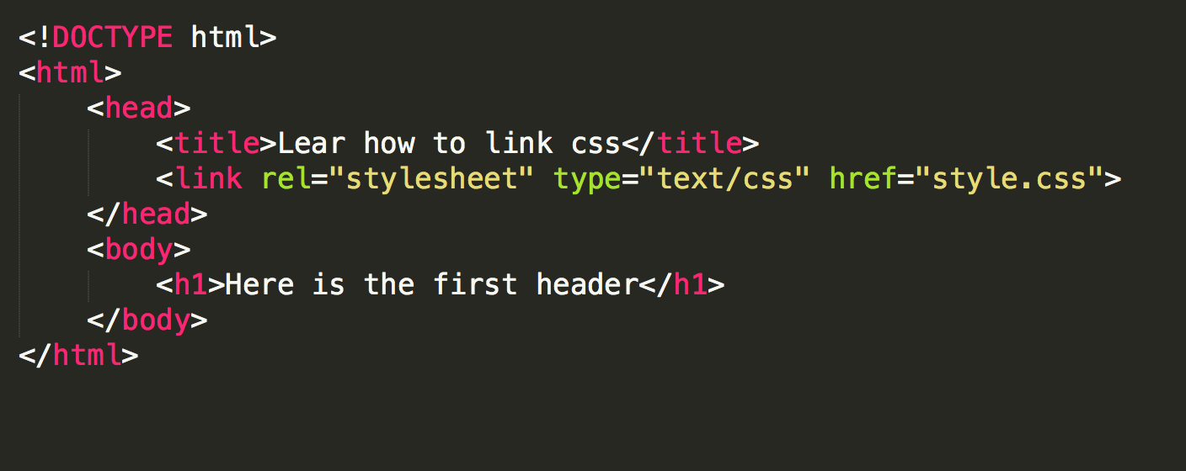
How to add CSS?
Link External File

Slide 9
CSS Selectors
TAG
ID
CLASS NAME
tag
#
.

Slide 10
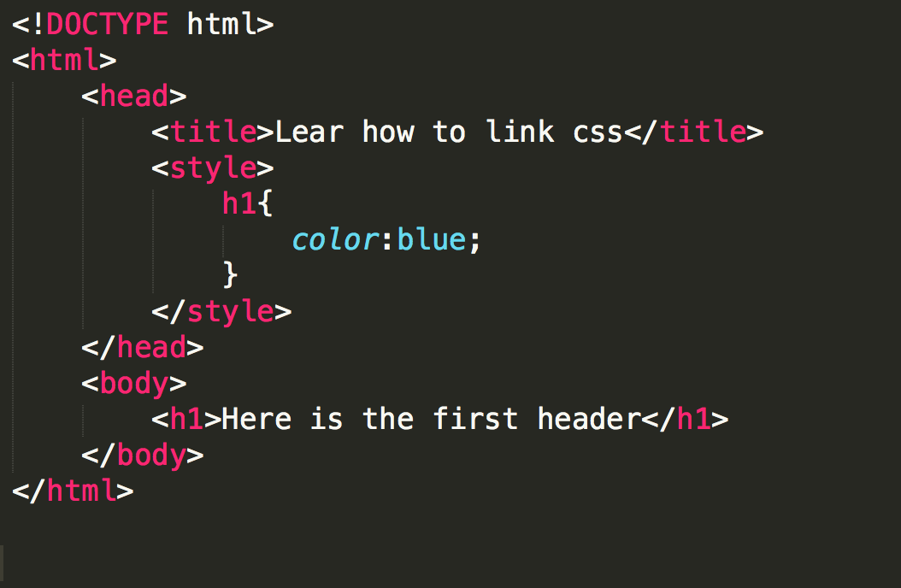
Tag

Slide 11
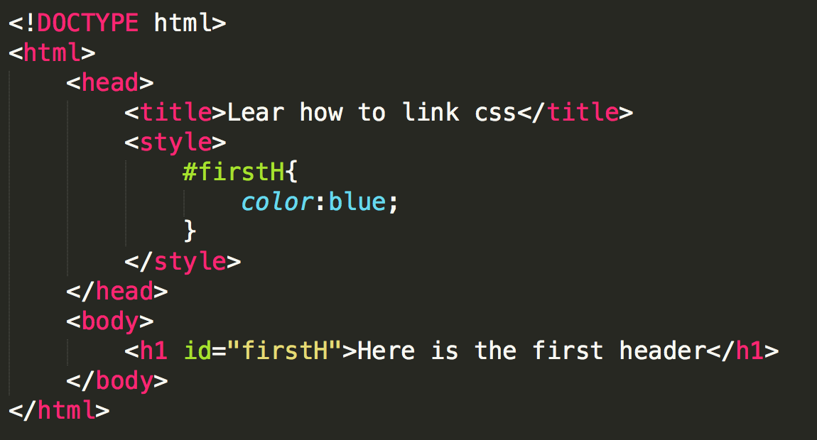
ID

Slide 12
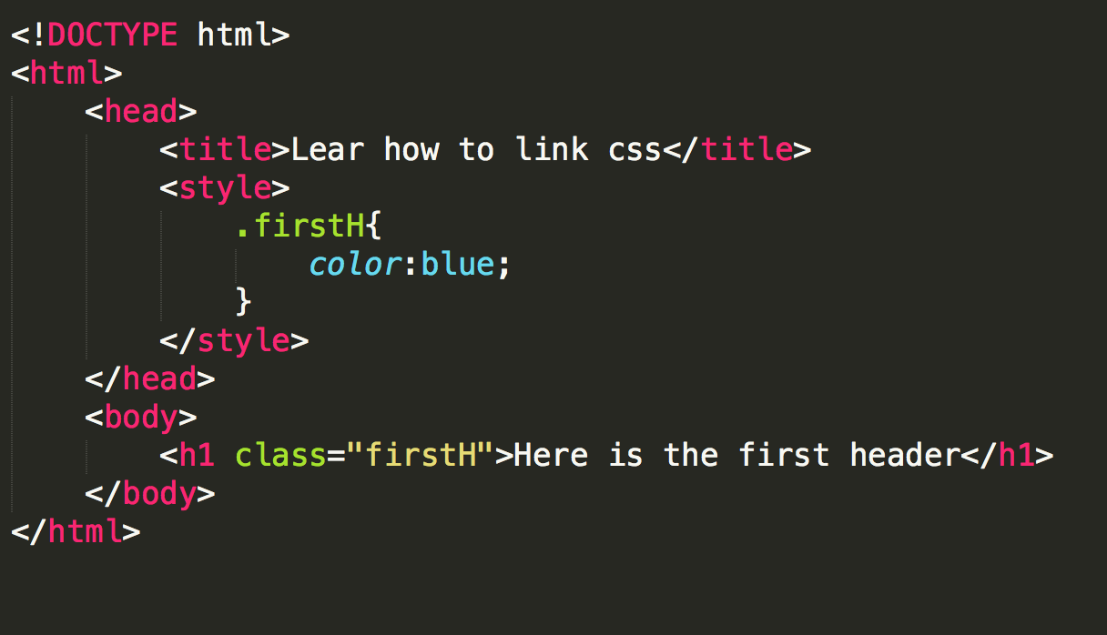
CLASS NAME

Slide 13

Most popular css properties
Display
Width & Height
Float
Color
Font
Background
Border
Padding
Margin
Great Resource

Slide 14
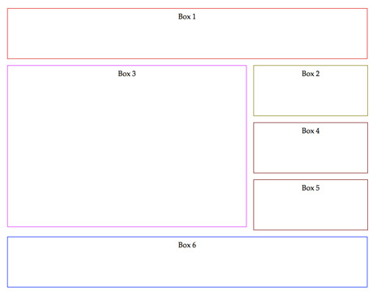
Think of boxes
Everything in a webpage is a box ! Always think of boxes.

Slide 15
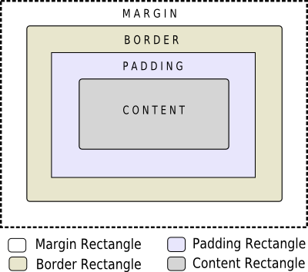
Box Model
Content - The content of the box, where text and images appear
Padding - Clears an area around the content. The padding is transparent
Border - A border that goes around the padding and content
Margin - Clears an area outside the border. The margin is transparent

Slide 16
Flex Box
L’et divs appear next to each other & order the boxes
AMAZING RESOURCE !
.parent {
display: flex;
height: 300px;
}
.child1{
order: 1;
width: 150px;
}
.child2{
order: 2;
width: 150px;
}

Slide 17
Why Responsive ?
Every device has different screen size, use viewport to match the device dimensions.
<meta name="viewport" content="width=device-width, initial-scale=1.0">
The initial-scale property controls the zoom level when the page is first loaded.
The width controls the size of the viewport. It can be set to a specific number of pixels like width=600or to the special value device-width

Slide 18
TIPS
Use relative width: set sizes in terms of percentages rather than pixels.
Specify max-width
Set the box-sizing attribute to border-box for every element.
Different browsers work slightly differently. Sometimes this causes different browsers to display the same code differently, so test your code in different browser.

Slide 19
Break Points & Media Query
@media only screen and (max-width: 600px) and (min-width: 400px) {...}
Most media queries are set to trigger at certain screen widths or breakpoints.

Slide 20
Grids-Based Layout
A grid is an intersecting set of horizontal and vertical lines – one set defining columns and the other rows.
How to use it?
Set display: grid;
Always wrap all divs
You can set gaps between grids
You can have nested grids
You can make two items overlap by using z-index
External Resource !

Slide 21
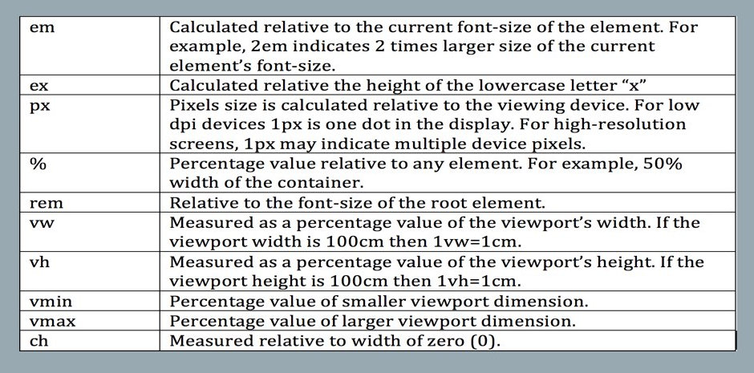
CSS Units

Slide 22
Optimization
Use relative sizes for images to prevent them from accidentally overflowing the container.
Use the picture element when you want to specify different images depending on device characteristics (Art direction).
Use srcset and the x descriptor in the img element to give hints to the browser about the best image to use when choosing from different densities.
If your page only has one or two images and these are not used elsewhere on your site, consider using inline images to reduce file requests.

Slide 23
ReadME Files
Documentation is important to explain your code and installation process.
It is a best way to allow other people to use it.
It could be written in many format but the recommended one is Markdown .md.
Most Important Command:
Bold: surrounded the text with double star **
Italics: surrounded the text with underscore _
Code: surrounded the code with single quote `
Header: start with hashtag # = h1 ## = h2 and so on
For extra command, click here

Slide 24

DevTools
https://www.nytimes.com

Slide 25
Exercise
Exercise (1): Media Query and Breakpoints
Between 0 and 500 → Set the background color to blue and text to white
Between 501 and 800 → Set the background color to orange and text to black
For larger screen → Set the background color to white and text to purple

Slide 26

bootstrap

Slide 27
Bootstrap Exercise
We will create a page that has different 3 boxes.
Let’s try it together. Click here

Slide 28
Build a Portfolio Site Project

Slide 29

Remember that we are here to help you
All you have to do is ASK!
Thank you for Attending

